Slide 1

Jeopardy Inspired Quiz Game
Madison Gibbons

Slide 2
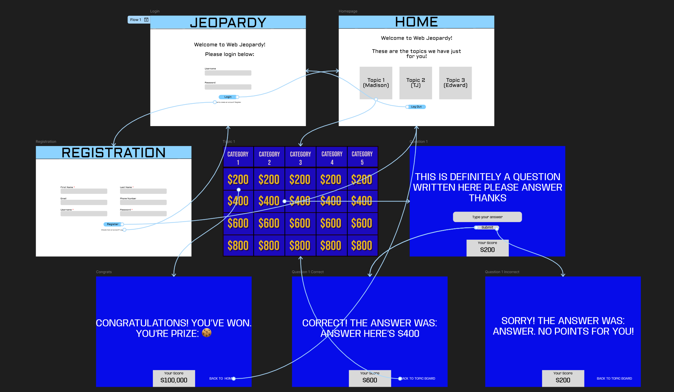
Diagram

Slide 3
Jeopardy
In this project, I created a web-based Jeopardy using HTML, CSS, and PHP. I utilized cookies and sessions to keep track of the questions and create a log in and registration system. Each page is password protected.

Slide 4
Login and Registration
I wanted to create both a login and registration system which is a typical option for most pages online. In a previous assignment, I used file I/O to read information in a text file and use it in a PHP page to identify each user.
I decided to use this as a rudimentary method of storing username and password. On the login page, that will be shown later in the demo, the user inputs their username and password and if the match is found in the file, they can login. If not, there’s an error message and it doesn’t move on.
At the bottom of the login page, there’s an option to register for an account.
Once the user logs in, they are presented with a homepage. This also initializes a session variable to keep track of the username and one to see if the user is logged in.

Slide 5
Login and Registration
On the registration page, the user can create an account. They must input their first and last name, along with a username and a password. There are optional email and phone number inputs as well for aesthetic. If the user inputs invalid information, they are asked to fix it and stops the file entry.
This is achieved through a validation function in the PHP code. It checks if any of the required entries are empty. If the user inputs invalid information for the non-required fields, it returns an error as well. However, they have the option to leave it blank. There is also a function that reads the username and checks if it is taken (already in the file).
Once the user input valid information, they are logged in and are led to the homepage. The information is written to a text file in a specific format for the user to log in later on.

Slide 6
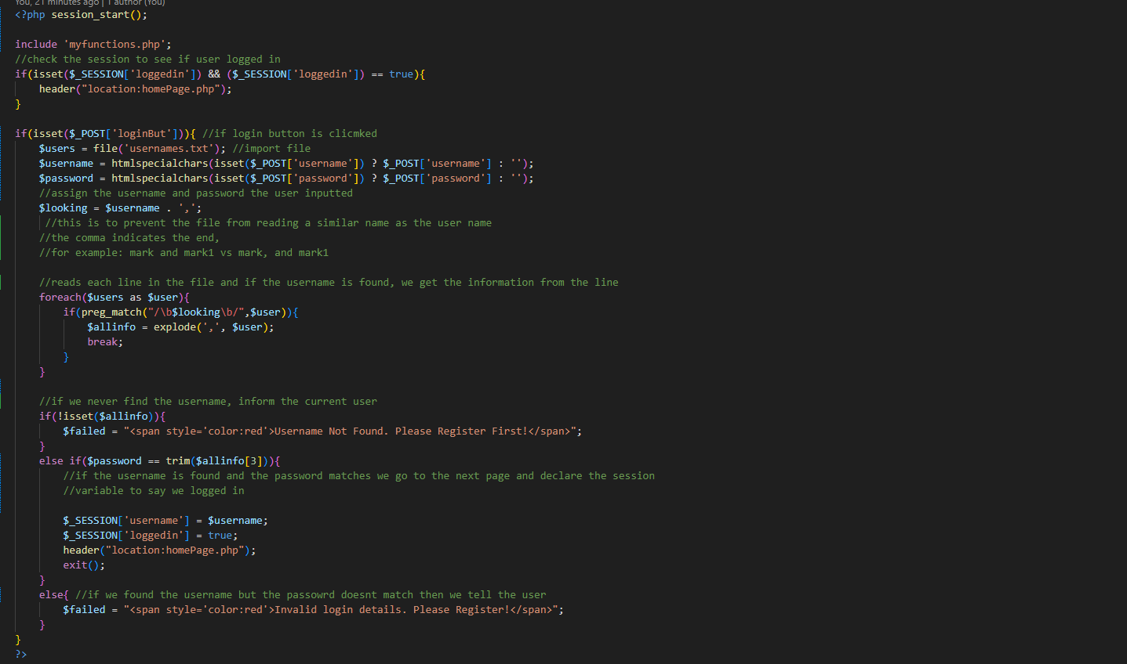
Login code

Slide 7
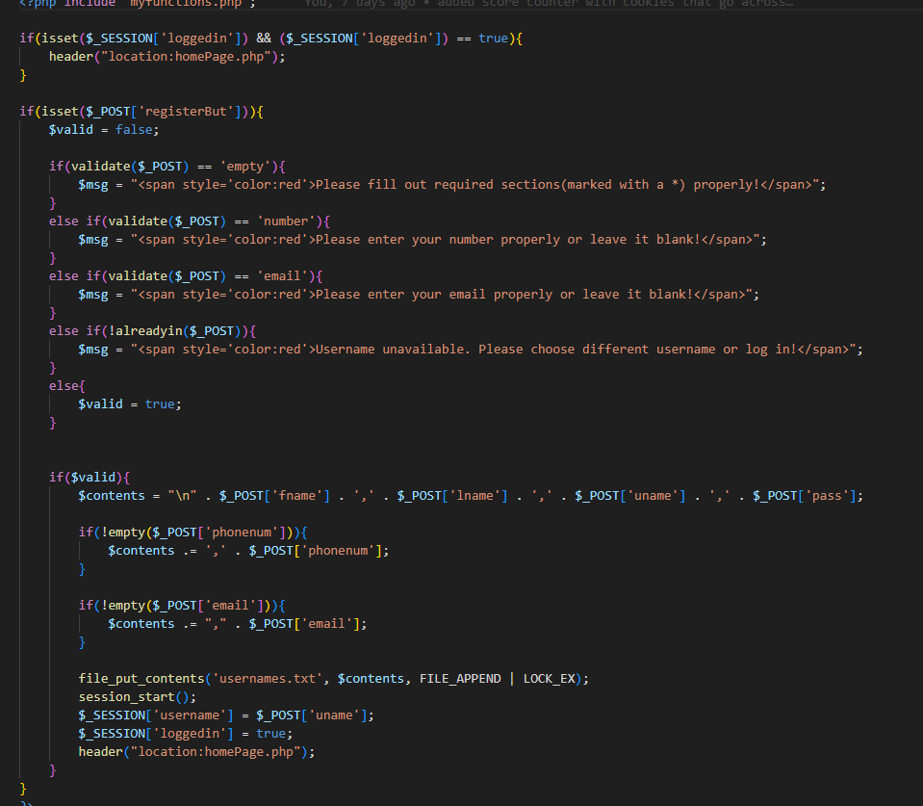
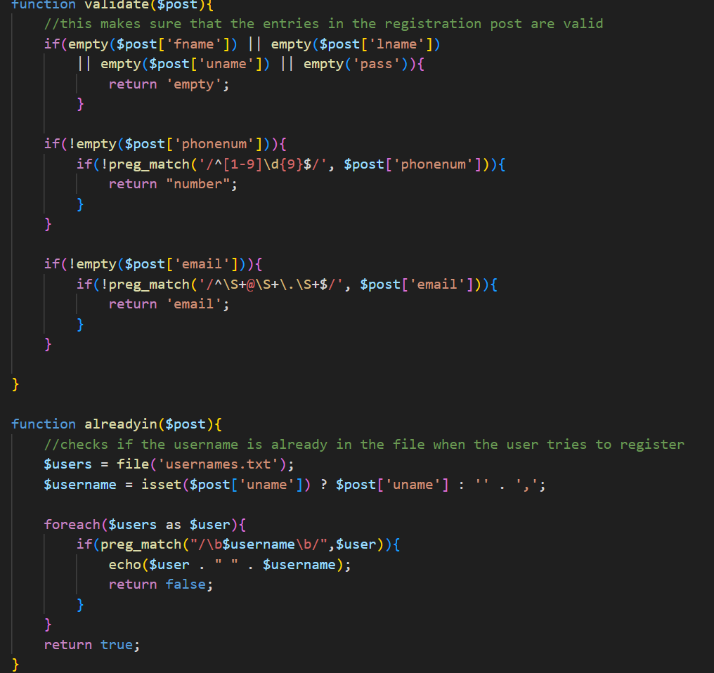
Registration code

Slide 8
Homepage
Once the user has logged in, they are presented with directions and three topics to play the game. This is a password protected page, so if the user is not logged in, it displays a message to ask the user to log in instead of the topics.
Every time this page is loaded, it resets the score cookie and the answered session variable that keeps track of the user’s answered questions.

Slide 9
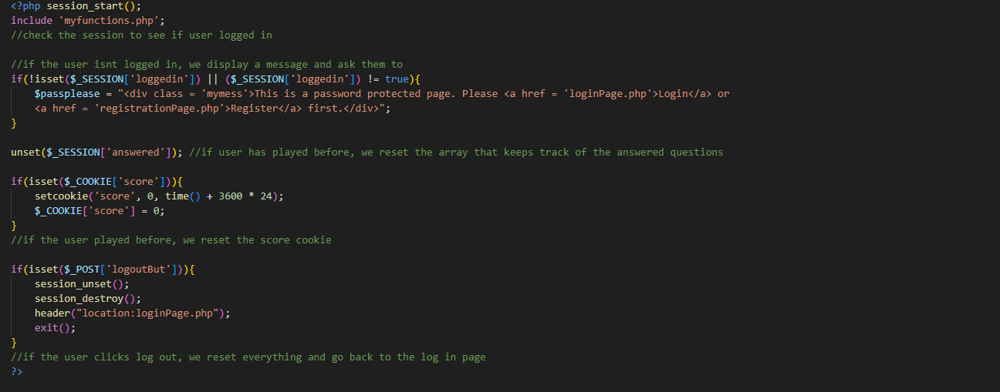
HOMEPAGE CODE

Slide 10
Topics
Each topic has the same design with different questions. It uses a CSS grid and has five different categories and 4 questions for each category. In each grid square, there is a money value which is a link that leads to the question with a difficulty level based on the value.
I used a PHP loop to lessen repetition.

Slide 11
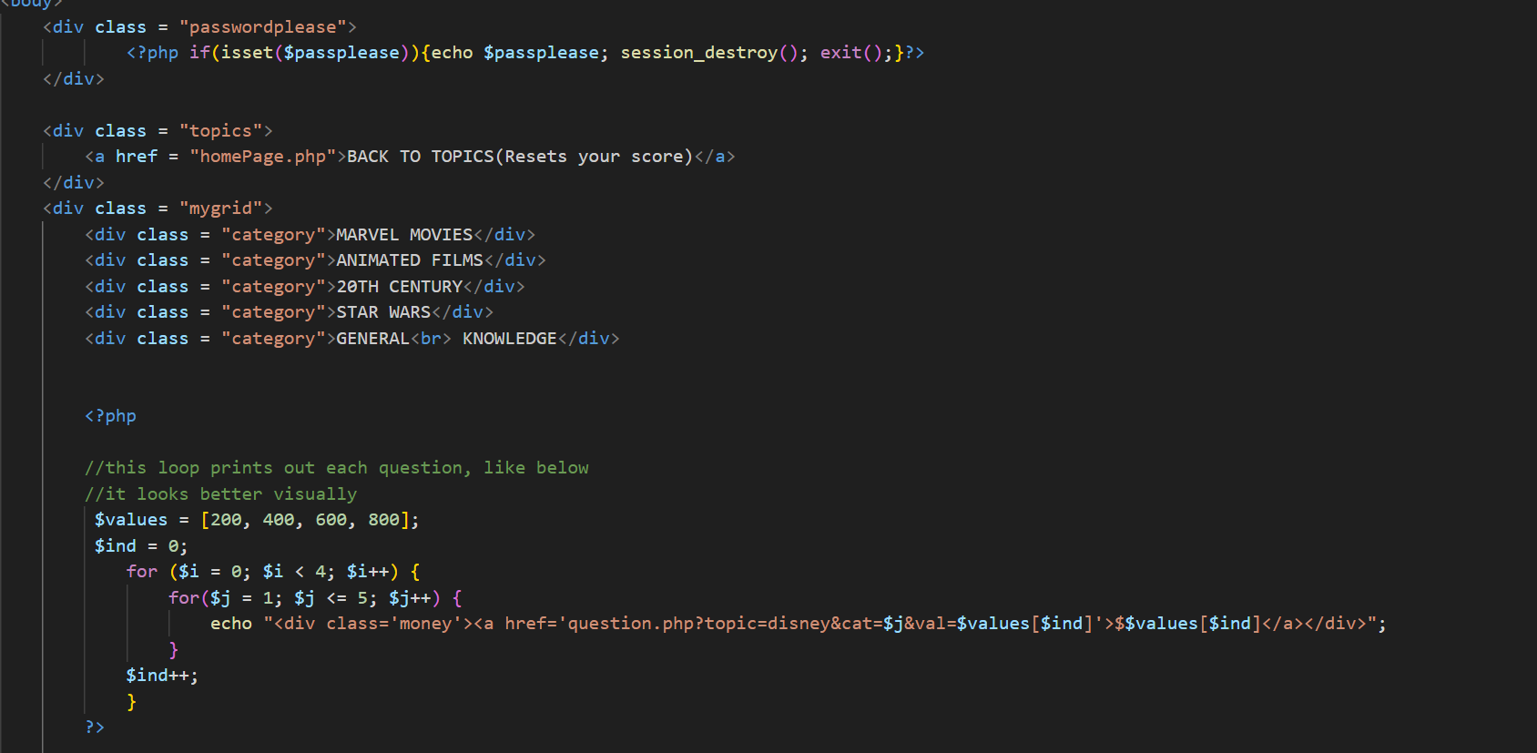
Disney Code

Slide 12
Question
Once the user clicks a value, they are redirected to a different page that checks the topic, category, and value. The code gets the question from an array and echoes the question along with a text box.
If the user has already answered the question, a message is displayed and asks the user to go to the previous page.
Once the user submits their answer, they are taken to an answer page.

Slide 13
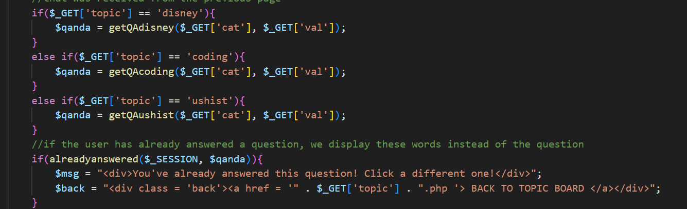
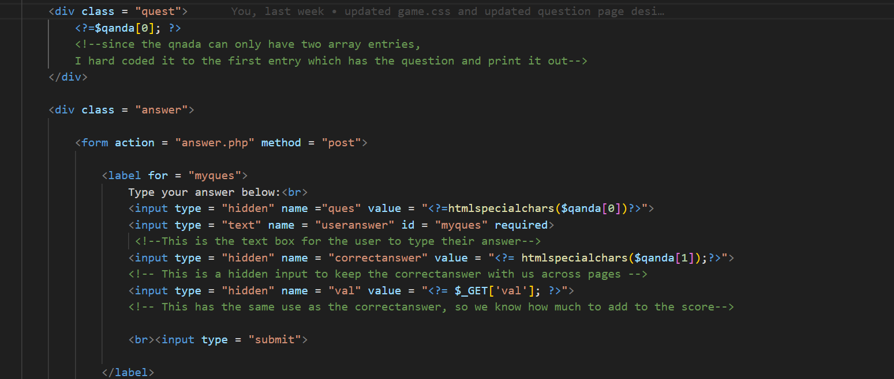
Question Code

Slide 14
Answer
This page displays whether the user is correct. It checks the user input from the previous form on the question page and compares it to the correct answer. If it is, we update the score and the answered session variable. If not, we don’t update the score but still update the answered variable.

Slide 15
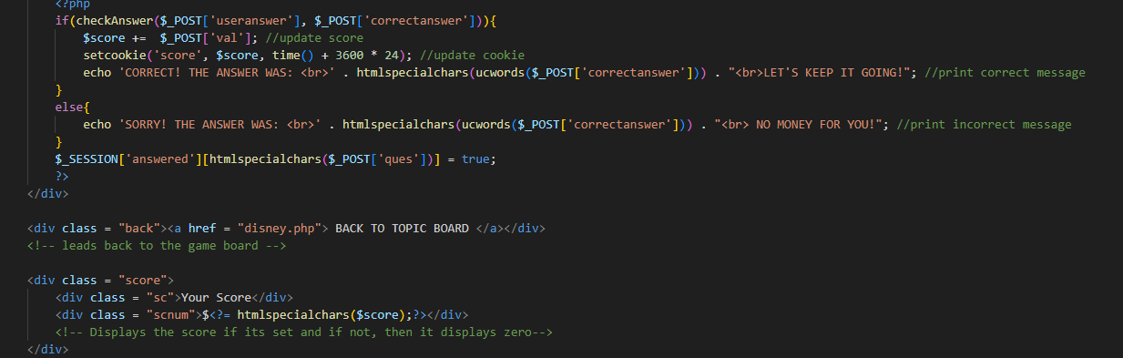
Answer

Slide 16
Ending
Once the user has answered all of the questions, we check the score cookie and if the user has enough points (a majority) we display a winning message and lead them back to the homepage so they can log out or go to a different topic.

Slide 17
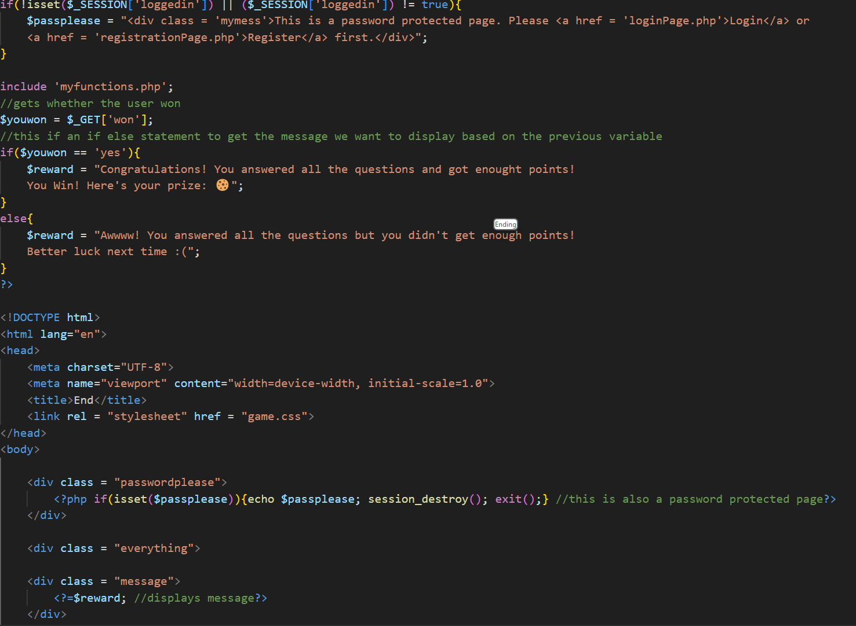
Ending

